Slide 1
HTTP, REST WEB SOCKETS

Slide 2


HTTP - HyperText Transfer Protocol
HTTP Request
HTTP Response
Client
Server

Slide 3
HTTP Request
Consists of:
Starting Line
GET http://www.site.com/users HTTP/1.1
HTTP method that describes action
Request path, usually URL
HTTP protocol version
Headers
GET /users HTTP/1.1 Host: site.com
Additional information of what the client wants and will accept back from the server (optional)
Body
Used for some types of requests that contain the resource

Slide 4



HTTP Methods
GET /users
POST /users body: { name: ‘Bob’, age: 40, gender: ‘M’}
PUT /users/1 body: { name: ‘Super Bob’, age: 40, gender: ‘M’}
PATCH /users/1 body: { age: 26 }
DELETE /users/2

Slide 5
HTTP Response
Consists of:
Starting Line
HTTP protocol version
Status Code
Status Code Name
HTTP/1.1 200 OK Content-Type: application/json, Content-Length: 70 [{ id: 1, name: ‘Dmitry’, age: 20, gender: ‘M’ }, … ]
Headers
Format of the received data, size of data and other details
HTTP/1.1 200 OK Content-Type: application/json, Content-Length: 9 { id: 3 }
Data
Requested data or error message

Slide 6
STATUS CODES
INFORMATIONAL 1xx
SUCCESS 2xx
REDIRECTION 3xx
The request was received, continuing process
102 Processing
The request was successfully received, understood, and accepted 200 OK
Further action needs to be taken in order to complete the request 307 Temporary Redirect
CLIENT ERROR 4xx
SERVER ERROR 5xx
The request contains bad syntax or cannot be fulfilled 401 Unauthorized
The server failed to fulfil an apparently valid request 500 Internal Server Error

Slide 7
HTTP Headers
General Headers
Request Headers
Response Headers
Transfer-Encoding, Date, Cache-Control Transfer-Encoding: chunked
User-Agent, Host, From User-Agent: Mozilla/5.0 (X11; Fedora; Linux x86_64) AppleWebKit...
Age, Allow, Location, Retry-After Retry-After: 25
Entity Headers
Content-Language, Content-length, Content-Type Content-Language: en, ase, ru

Slide 8
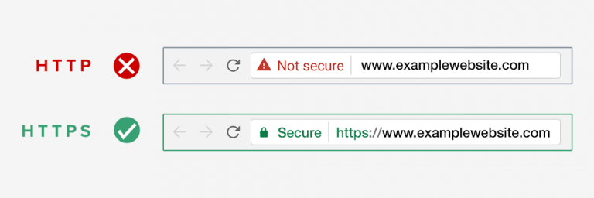
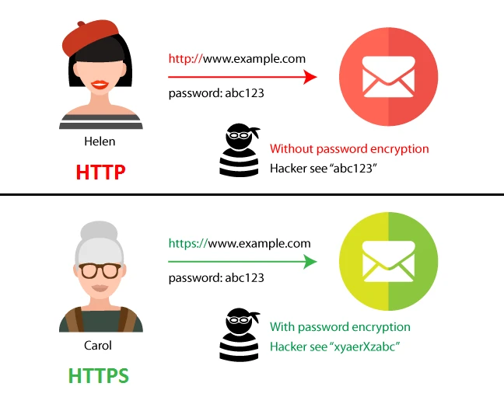
HTTPS - HyperText Transfer Protocol Secure
HTTPS - is an extension for HTTP protocol that implements encryption to increase security. Encryption - Transport Layer Security (TLS) or Secure Sockets Layer (SSL).

Slide 9
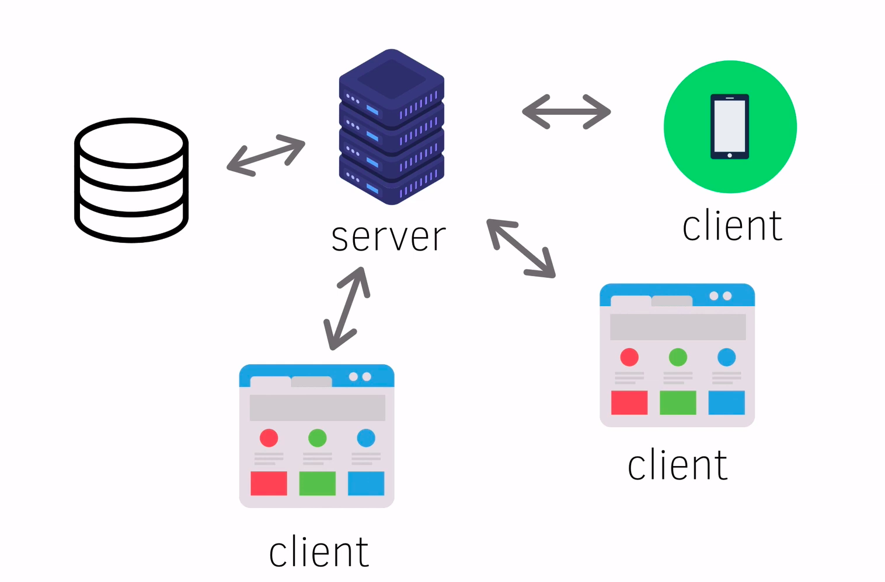
REST API
REST - REpresentational State Transfer API - Application Programming Interface

Slide 10
Restrictions of REST
Client-server model
Stateless
Caching
The system consists of clients and servers. These parts are not connected
No info of client state shouldn’t be stored on server between requests
Intermediate nodes can be used. Responses that came from cached should be signed as such
Layered system
Uniform Interface
Code on demand
Client shouldn’t know if interacts with server or intermediate node
Resource identification in requests
Manipulation via representation
Self-descriptive messages
Hypermedia as the engine of application state
Additional appliets can be used if needed

Slide 11
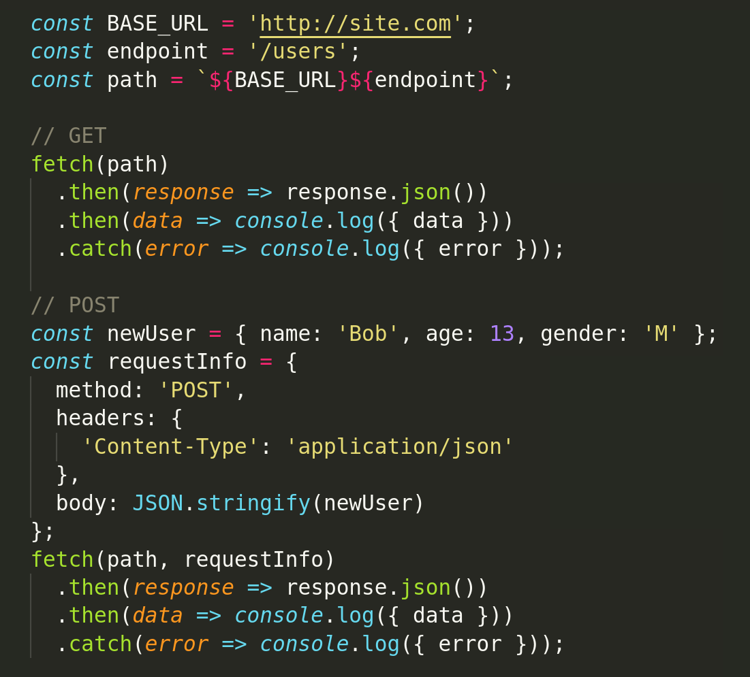
JS fetch API
const promise = fetch(path, [options]);
path - URL to access
options - optional parameters: method, headers, etc.
Response .headers - The headers object associated with response .ok - Boolean. Return true if status in the range 200 - 299 .status - status code
.json() - format response to json .statusText - status text ...

Slide 12
Simple RESTful API example
Method | http://site.com/users | http://site.com/users/:id
GET | 200 OK list of users | 200 OK get object with specific id 404 Not Found object with such id doesn’t exist
POST | 201 Created object was added to the list 422 Unprocessable Entity required fields are missing | 405 Method Not Allowed adding an object to an object is not supported
PUT | 405 Method Not Allowed updating the list isn’t supported | 200 OK object was updated 404 Not Found object with such id doesn’t exist
DELETE | 405 Method Not Allowed deleting the list isn’t supported | 200 OK object was deleted 404 Not Found object with such id doesn’t exist

Slide 13
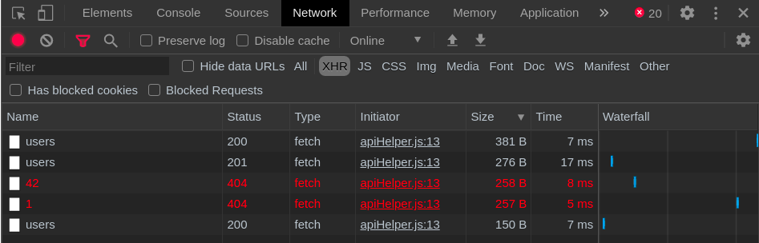
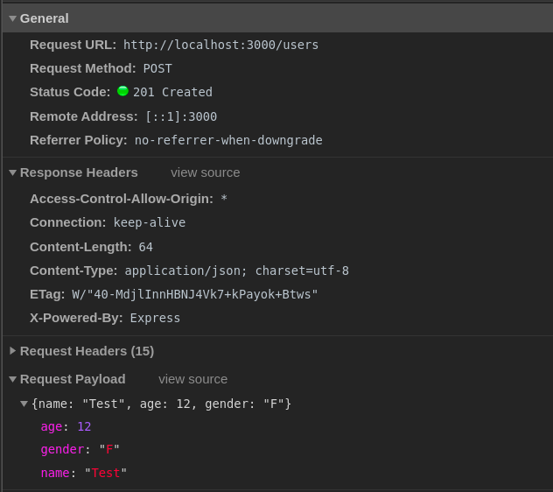
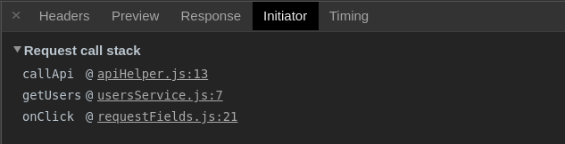
Devtools Network tab

Slide 14
Bi - Directional Transport
Client
Server
Client

Slide 15
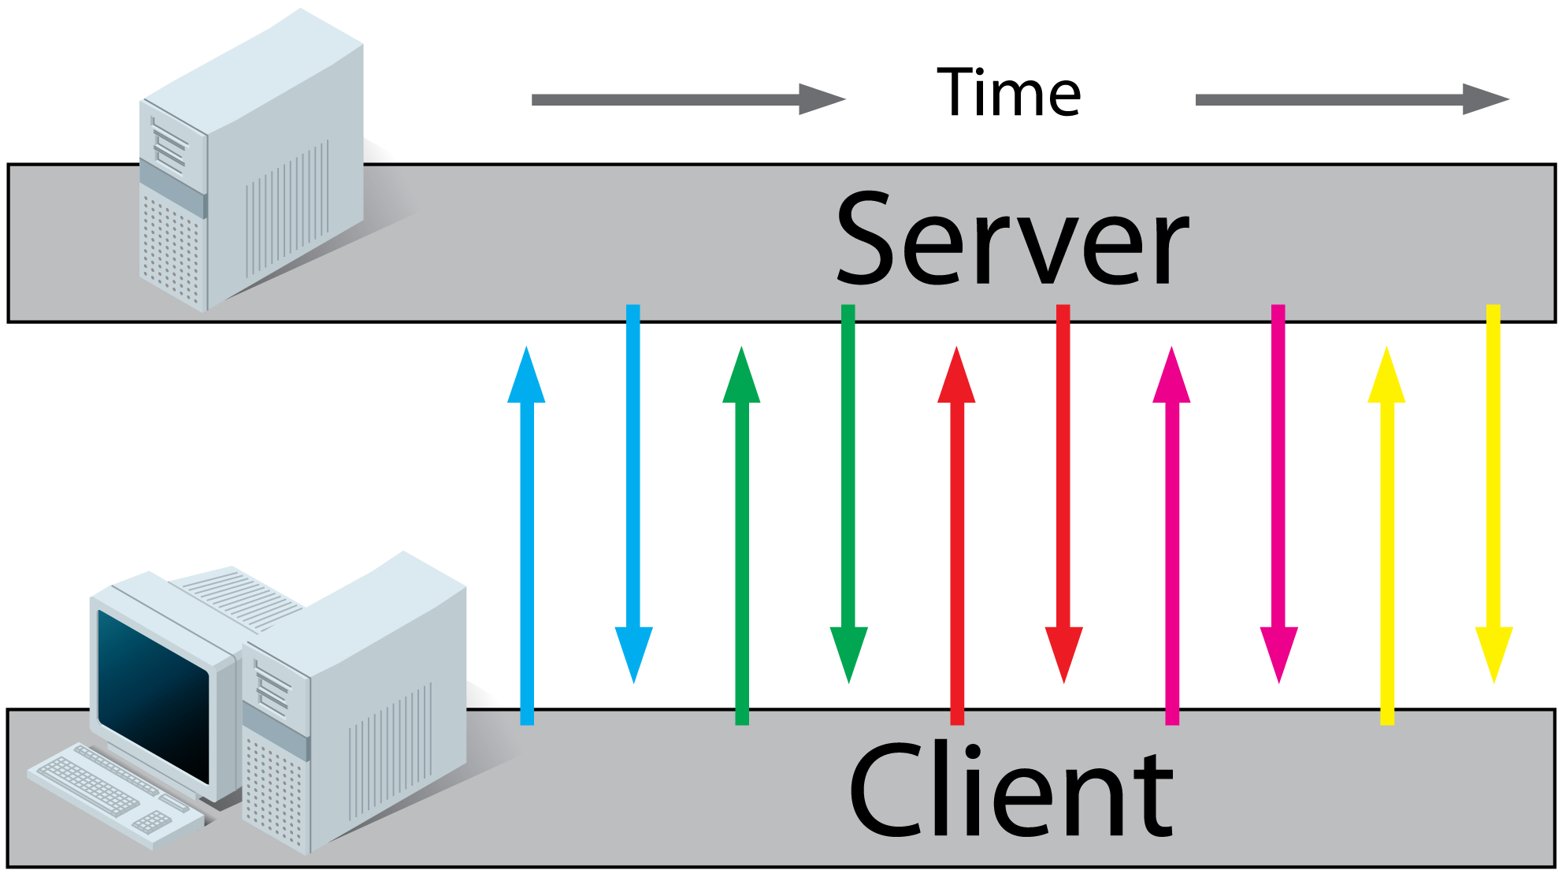
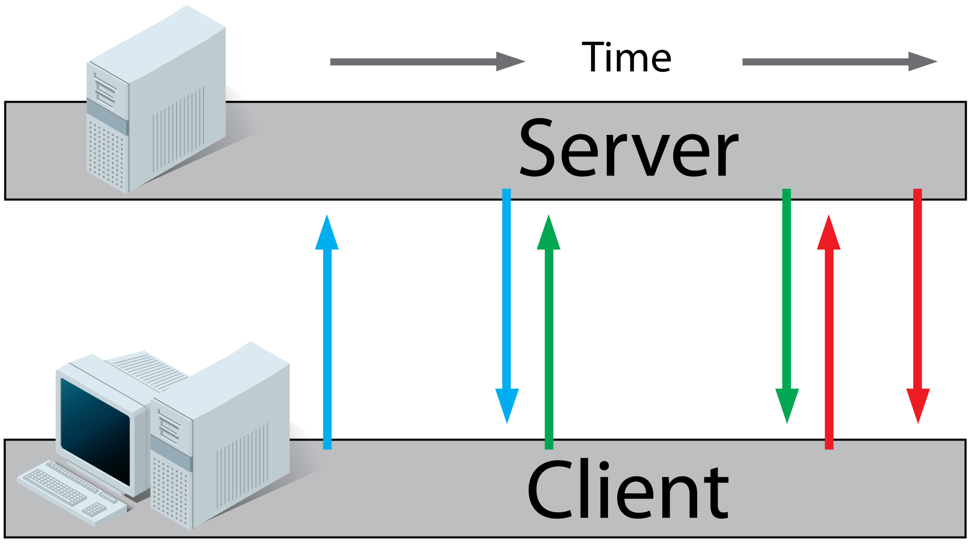
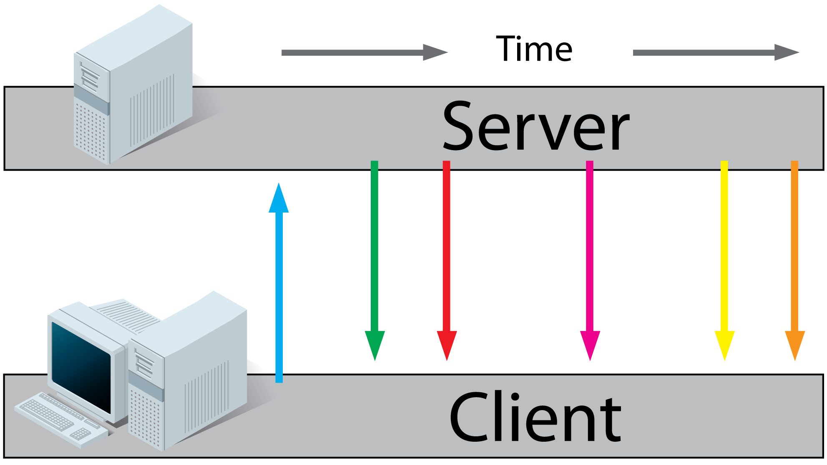
Client-Server Communication
Polling
Long Polling
Server-Sent Events (SSE)
Asking server for new info each N milliseconds
Server responds at the moment when new data was added
Client and server switch places

Slide 16
WebSocket protocol
Request
Hand Shake
Web Socket ( ws:// )
Client
Server

Slide 17
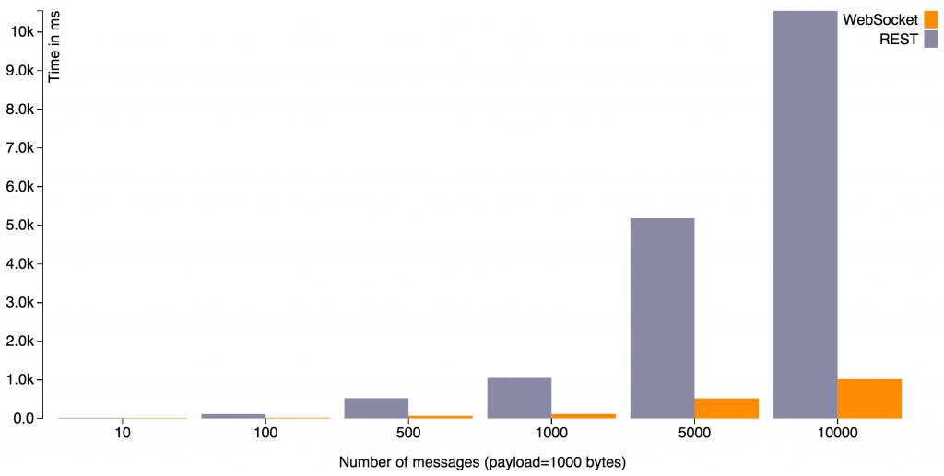
Performance

Slide 18
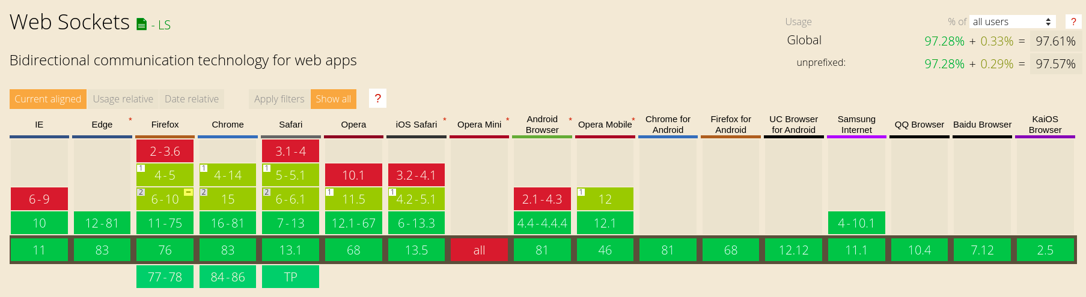
Support for Browsers

Slide 19
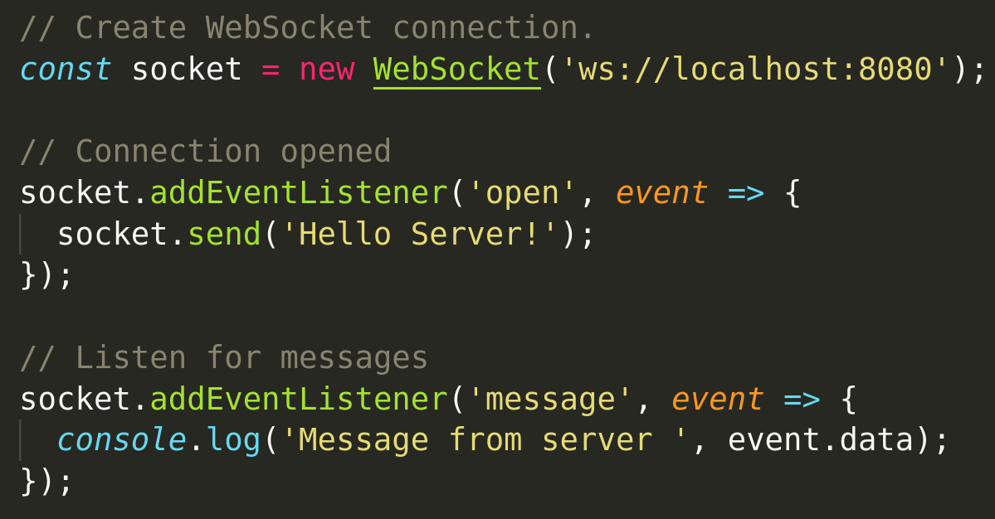

How to use WebSockets?
Native WebSocket (client)
Use native WebSocket instance for client and any library for server (for example - ws)
Socket.io (client and server)
Is a library that enables real-time connection and consists of:
Node.js server
JavaScript client library for the browser

